Slide 1

Lecture 3
Fundamentals and Applications (CSO201A)
Dr. Srinivas Dharavath
Assistant Professor
Department of Chemistry
Indian Institute of Technology, Kanpur
Kanpur- 208016
E-mail: srinivasd@iitk.ac.in

Slide 2
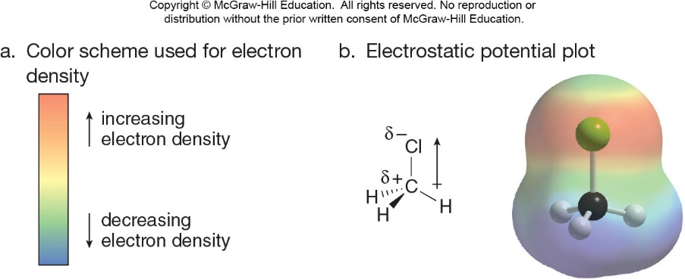

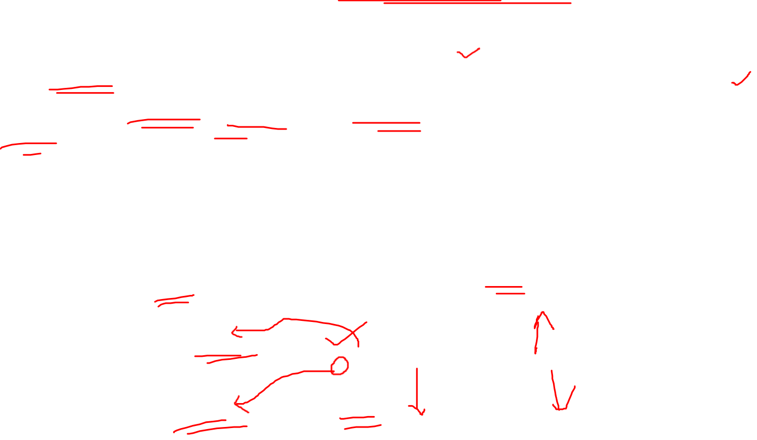
Polarity of Molecules
Use the following procedure to determine if a molecule has a net dipole:
Use electronegativity differences to identify all of the polar bonds and the directions of the bond dipoles.
Determine the geometry around individual atoms by counting groups, and decide if individual dipoles cancel or reinforce each other in space.
Electrostatic potential plot of CH₃Cl
Organic Chemistry Sixth Edition, Janice Gorzynski Smith University of Hawai’I Chapter 1,3 and 6

Slide 3
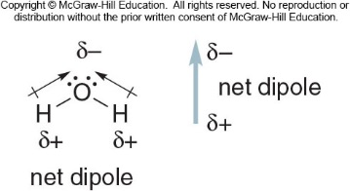
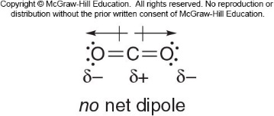

Polar Molecules
A polar molecule has either one polar bond, or two or more bond dipoles that reinforce each other. An example is water: It is a bent molecule
Two dipoles reinforce
It has a net dipole, making it a polar molecule
Nonpolar Molecules
A nonpolar molecule has either no polar bonds, or two or more bond dipoles that cancel. An example is carbon dioxide:
It is a linear molecule
Two dipoles are equal and opposite in direction
Two dipoles cancel
It is a nonpolar molecule with no net dipole
Organic Chemistry Sixth Edition, Janice Gorzynski Smith University of Hawai’I Chapter 1,3 and 6

Slide 4
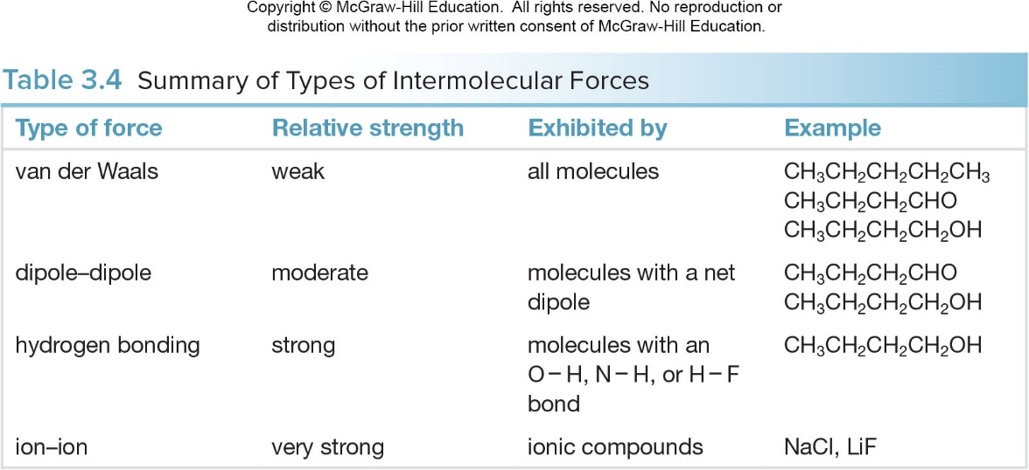
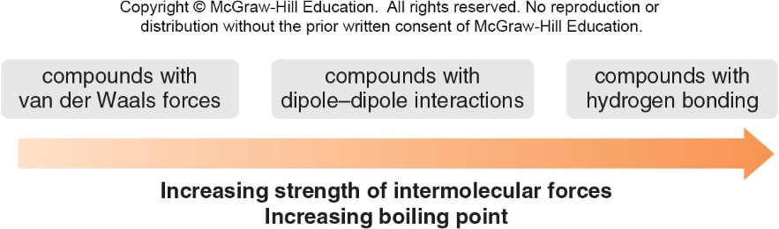

Intermolecular Forces-Summary
As the polarity of an organic molecule increases, so does the strength of its intermolecular forces.
Physical Properties—Boiling Point
The boiling point of a compound is the temperature at which liquid molecules are converted into gas.
In boiling, energy is needed to overcome the attractive forces in the more ordered liquid state.
The stronger the intermolecular forces, the higher the boiling point.
For compounds with approximately the same molecular weight:

Slide 5
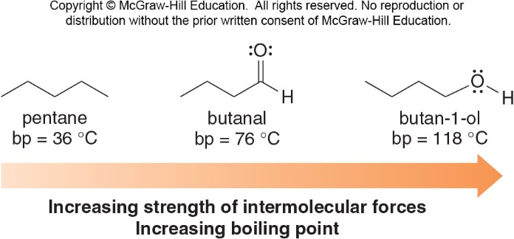
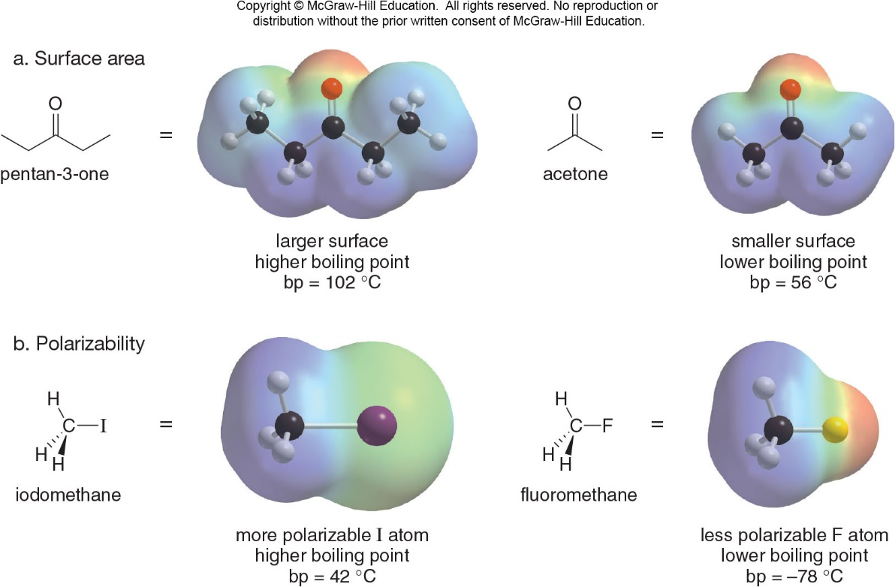

Boiling Point and Intermolecular Forces
The relative strength of the intermolecular forces increases from pentane to butanal to 1-butanol.
The boiling points of these compounds increase in the same order.
Other Factors Affecting Boiling Points
For compounds with similar functional groups, boiling point increase as: The surface area increases. The polarizability of the atoms increases.
Organic Chemistry Sixth Edition, Janice Gorzynski Smith University of Hawai’I Chapter 1,3 and 6

Slide 6
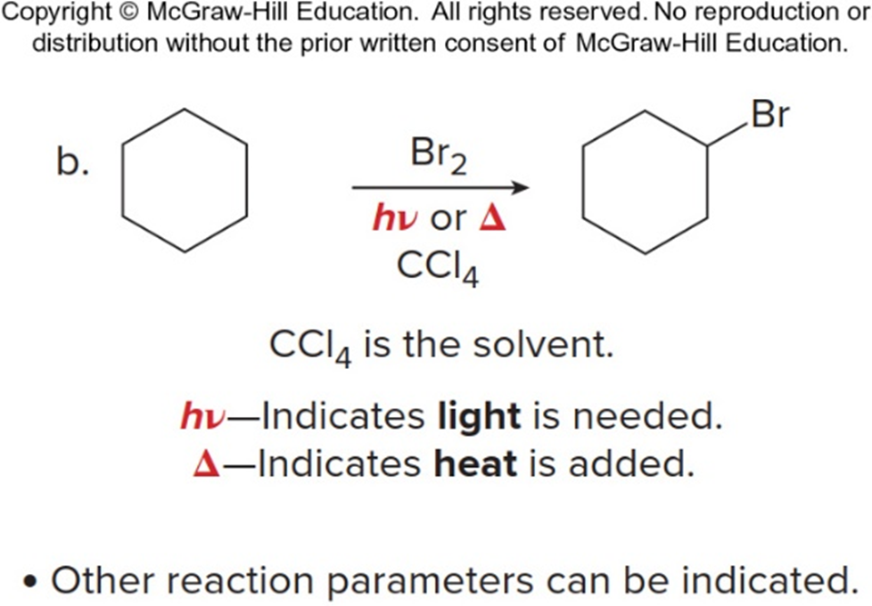
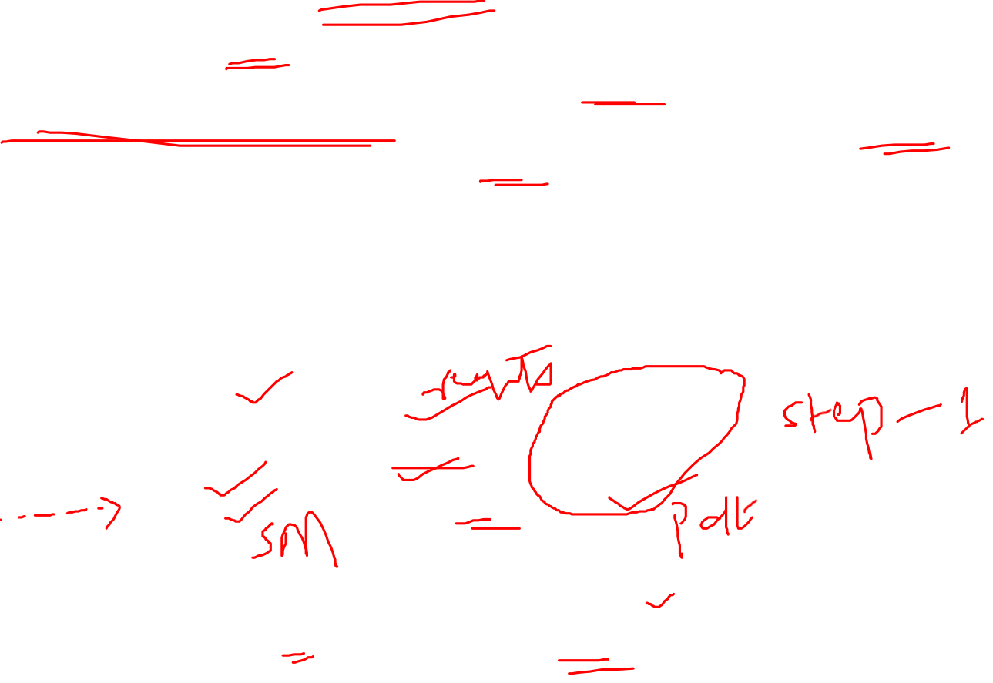
Organic Reactions
Reactions are at the heart of Organic Chemistry.
Virtually all chemical reactions are woven together by a few basic themes.
Begin by looking for electron-rich or deficient sites at functional groups in the reacting molecules.
These are often the location of bonds that might be easily broken.
Learn about how reaction takes place (i.e., does it occur in one step or in a series of steps).
Writing Equations for Organic Reactions
Equation for organic reactions are usually drawn with a
Organic Chemistry Sixth Edition, Janice Gorzynski Smith University of Hawai’I Chapter 1,3 and 6

Slide 7
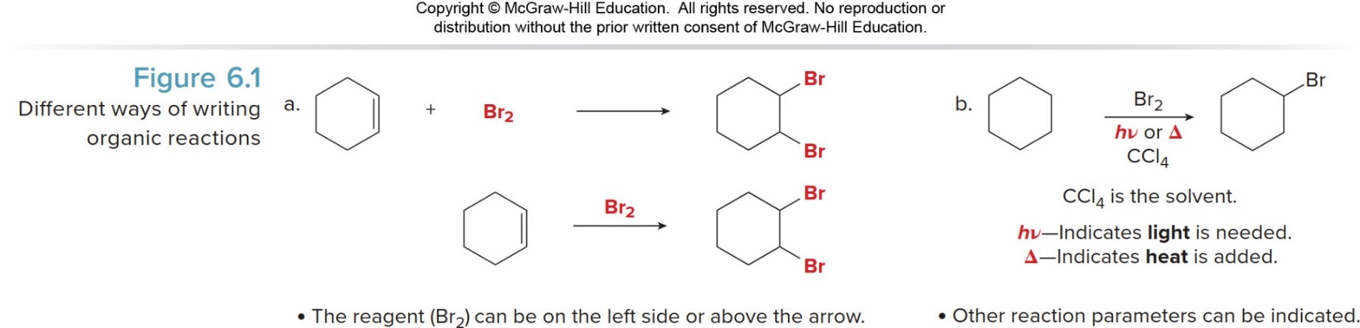
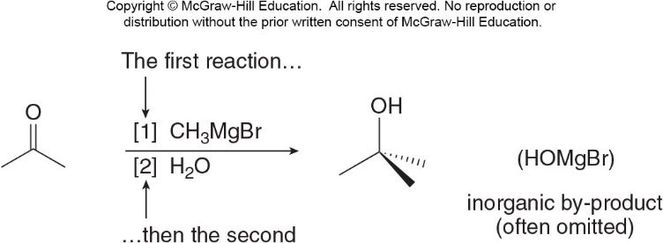

Ways to Write Organic Reactions
The solvent and temperature of the reaction may be added above or below the arrow.
The symbols “hν” and “Δ” are used for reactions that require light or heat, respectively.
Writing Equations for Sequential Reactions
When two sequential reactions are carried out, the steps are numbered above or below the reaction arrow.
This convention signifies that the first step occurs before the second step, and the reagents are added in sequence, not at the same time.

Slide 8
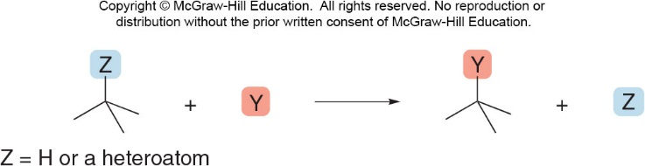
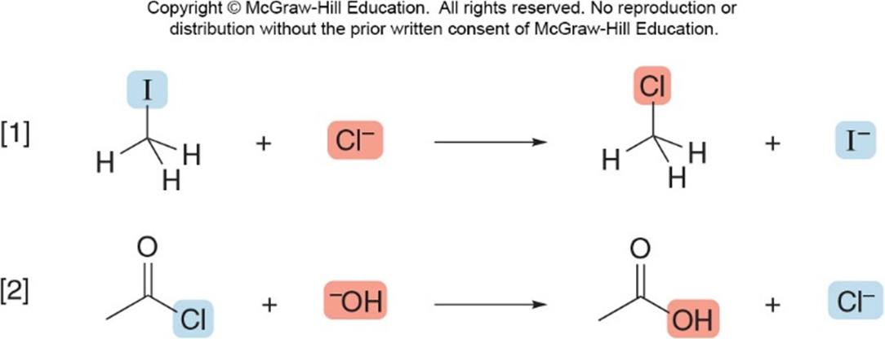

Substitution Reactions
Substitution is a reaction in which an atom or a group of atoms is replaced by another atom or group of atoms.
In a general substitution, Y replaces Z on a carbon atom.
Substitution Reactions-1
Substitution reactions involve σ bonds: one σ bond breaks and another forms at the same carbon atom.
While in some cases Z can be a hydrogen atom, the most common examples of substitution occur when Z is a heteroatom that is more electronegative than carbon.

Slide 9
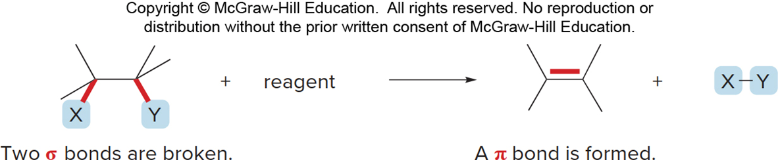
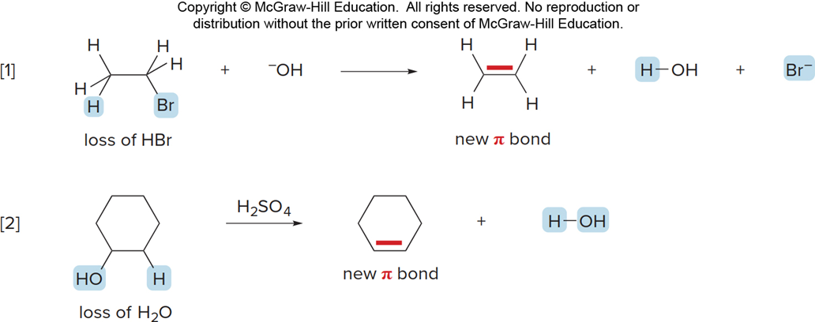

Elimination Reactions
Elimination is a reaction in which elements of the starting material are “lost” and a π bond is formed.
Elimination Reactions-1
In an elimination reaction, two groups X and Y are removed from a starting material.
Two bonds are broken, and a bond is formed between adjacent atoms.
The most common examples of elimination occur when X = H and Y is a heteroatom more electronegative than carbon.
Organic Chemistry Sixth Edition, Janice Gorzynski Smith University of Hawai’I Chapter 1,3 and 6

Slide 10
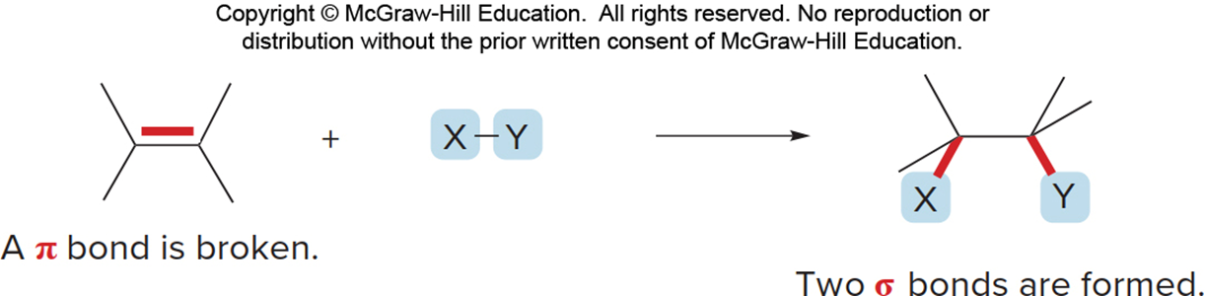
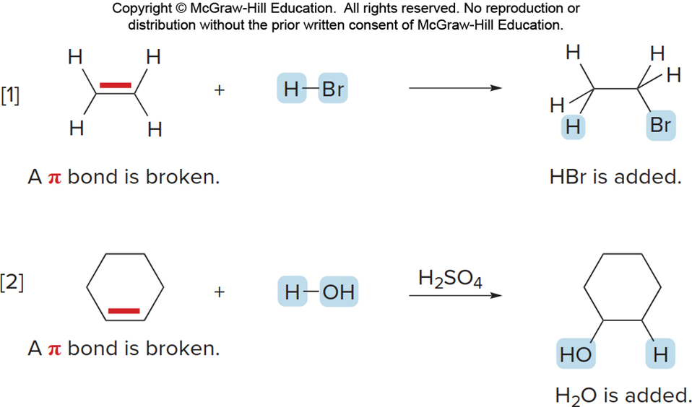

Addition Reactions
Addition is a reaction in which elements are added to the starting material.
Addition Reactions-1
In an addition reaction, new groups X and Y are added to the starting material.
A π bond is broken and two σ bonds are formed.
Organic Chemistry Sixth Edition, Janice Gorzynski Smith University of Hawai’I Chapter 1,3 and 6

Slide 11
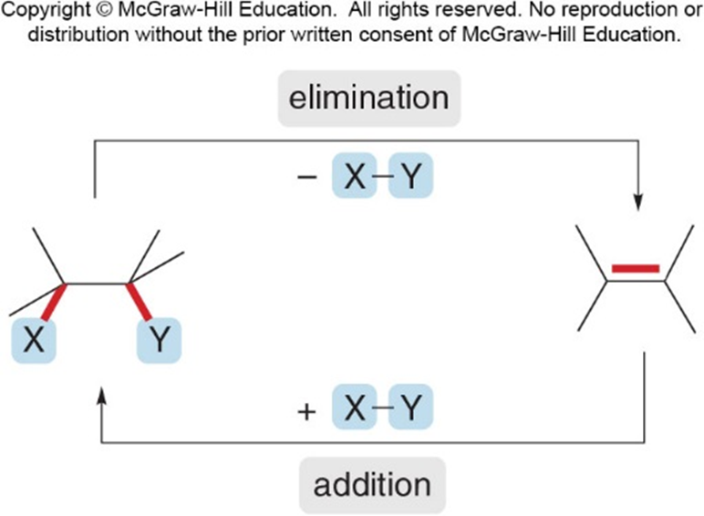

Relationship of Addition and Elimination Reactions
Addition and elimination reactions are exactly opposite.
A π bond is formed in elimination reactions, whereas a π bond is broken in addition reactions.
Often these reactions are reversible.
Organic Chemistry Sixth Edition, Janice Gorzynski Smith University of Hawai’I Chapter 1,3 and 6

Slide 12
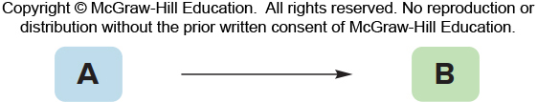
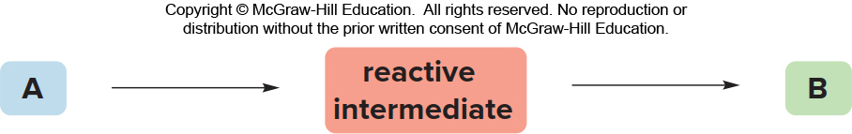

Reaction Mechanisms-1
A reaction mechanism is a detailed description of how bonds are broken and formed as starting material is converted into product.
A reaction can occur either in one step or a series of steps.
A one-step reaction is called a concerted reaction. No matter how many bonds are broken or formed, a starting material is converted directly to a product.
Reaction Mechanisms-2
A stepwise reaction involves more than one step.
A starting material is first converted to an unstable intermediate (reactive intermediate) which then goes on to form the product.
Organic Chemistry Sixth Edition, Janice Gorzynski Smith University of Hawai’I Chapter 1,3 and 6

Slide 13
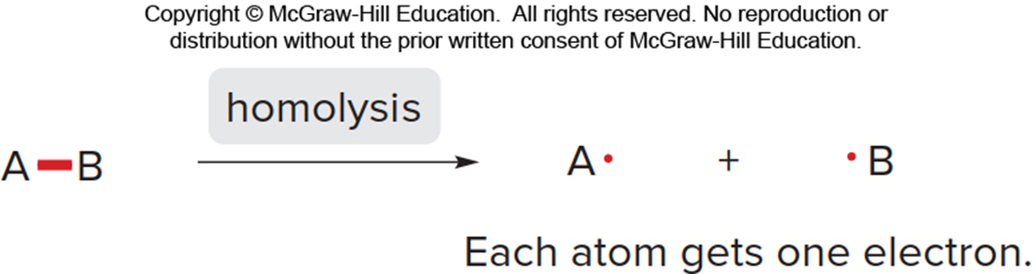
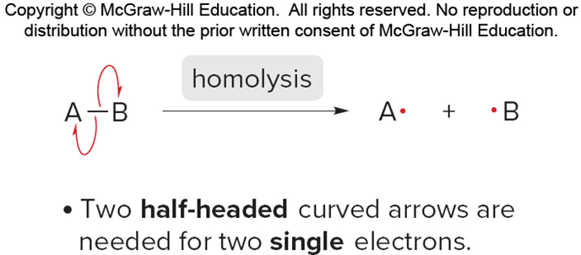

Bond Breaking–Homolytic
Regardless of how many steps there are in a reaction, there are only two ways to break (cleave) a bond.
The electrons in the bond can be divided equally or unequally between the two atoms of the bond.
Breaking a bond by equally dividing the electrons between the two atoms in the bond is called homolysis or homolytic cleavage.
Bond Breaking–Homolytic-1
To illustrate the movement of a single electron, use a half-headed curved arrow, sometimes called a fishhook.
Homolysis generates two uncharged species with unpaired electrons.
A reactive intermediate with a single unpaired electron is called a radical.
Radicals are highly unstable because they contain an atom that does not have an octet of electrons.
Organic Chemistry Sixth Edition, Janice Gorzynski Smith University of Hawai’I Chapter 1,3 and 6

Slide 14
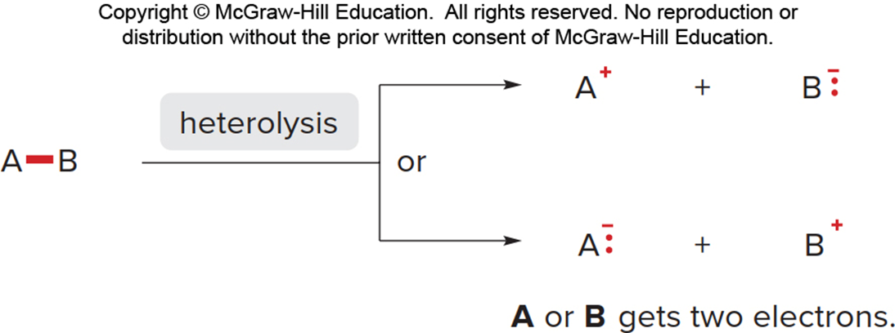
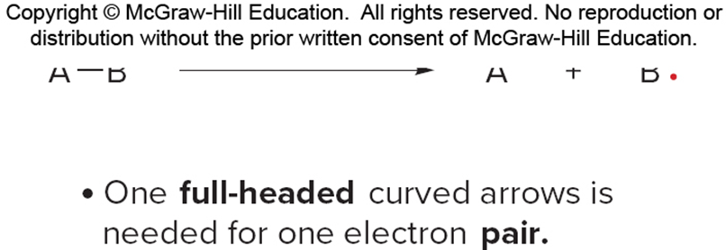
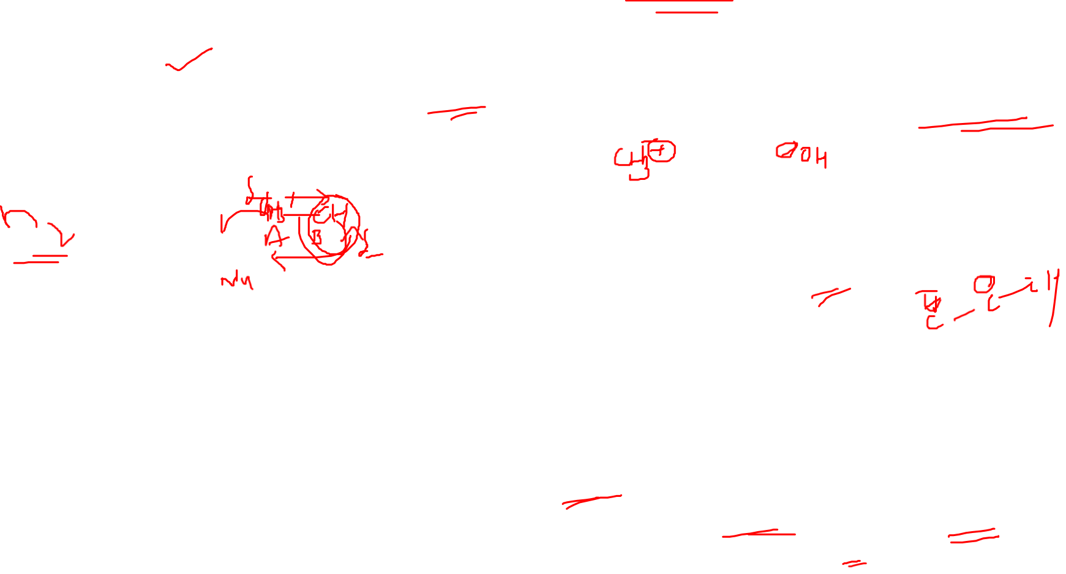
Bond Breaking–Heterolytic
Breaking a bond by unequally dividing the electrons between the two atoms in the bond is called heterolysis or heterolytic cleavage.
When two atoms have different electronegativities, the electrons end up on the more electronegative atom.
Bond Breaking–Heterolytic-1
A full-headed curved arrow shows the movement of an electron pair.
Heterolysis of a C—Z bond generates a carbocation or a carbanion.
A carbocation is an unstable intermediate containing a carbon surrounded by only six electrons.
A carbanion is an unstable intermediate having a negative charge on carbon, which is not a very electronegative atom.
Organic Chemistry Sixth Edition, Janice Gorzynski Smith University of Hawai’I Chapter 1,3 and 6

Slide 15
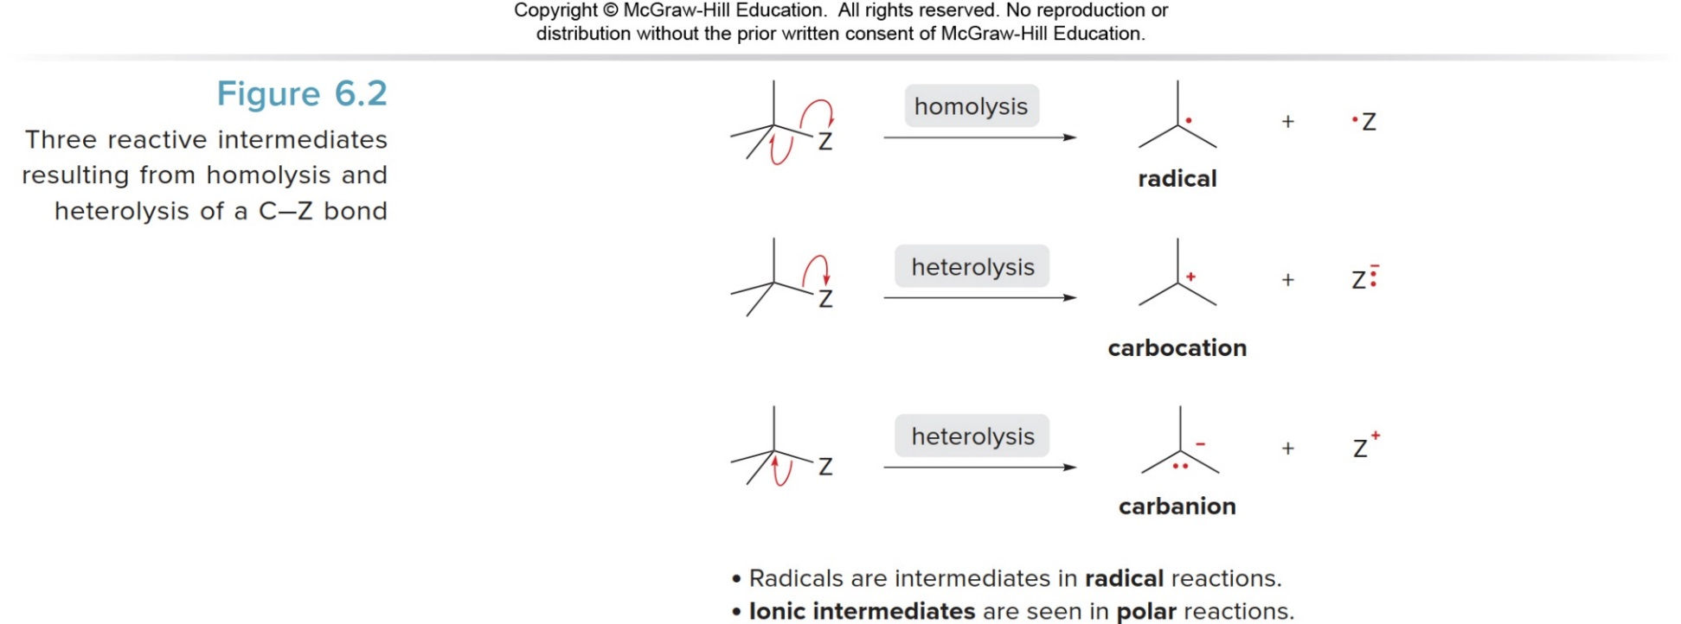

Reactive Intermediates Resulting from Breaking a C-Z Bond
Organic Chemistry Sixth Edition, Janice Gorzynski Smith University of Hawai’I Chapter 1,3 and 6

Slide 16
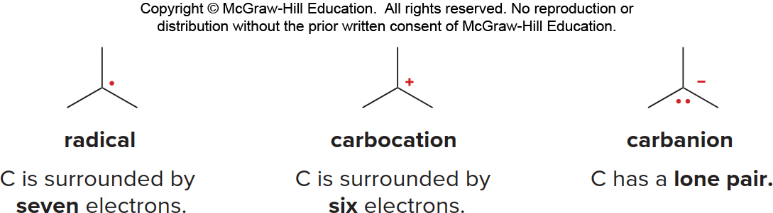
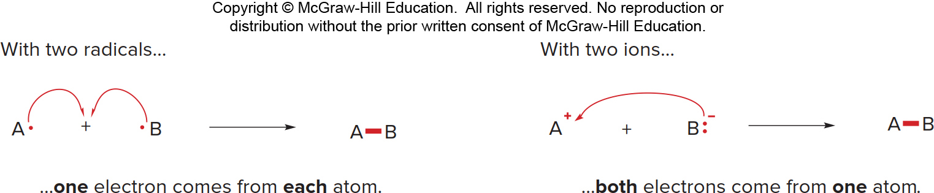

Bond Breaking–Intermediates
Radicals and carbocations are electrophiles because they contain an electron-deficient carbon.
Carbanions are nucleophiles because they contain a carbon with a lone pair.
Bond Forming
Bond formation occurs in two different ways.
Two radicals can each donate one electron to form a two-electron bond.
Two ions with unlike charges can come together, with the negatively charged ion donating both electrons to form the resulting two-electron bond.
Bond formation always releases energy.

Slide 17
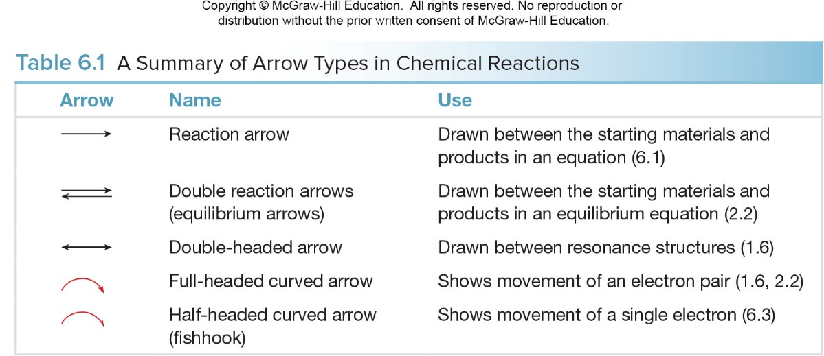

Arrows Used in Organic Reactions
Organic Chemistry Sixth Edition, Janice Gorzynski Smith University of Hawai’I Chapter 1,3 and 6

Slide 18
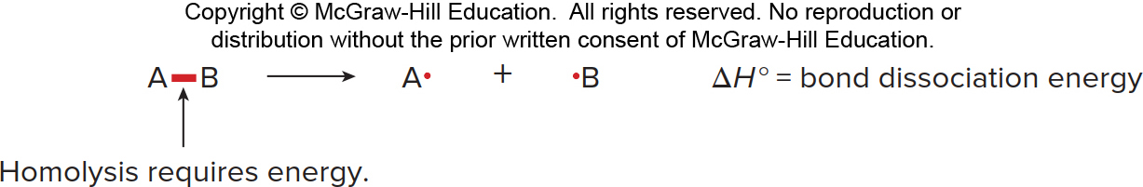
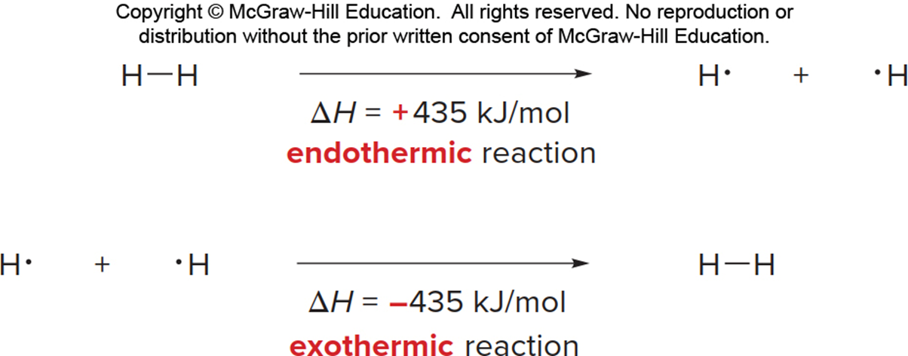

Bond Dissociation Energy
Bond dissociation energy is the energy needed to homolytically cleave a covalent bond.
Because bond breaking requires energy, bond dissociation energies are always positive numbers, and homolysis is always endothermic. Conversely, bond formation always releases energy, and thus is always exothermic.
Energy Associated with the 𝐇𝟐 Bond
As an example, the H—H bond requires +435 kJ/mol to cleave and releases −435 kJ/mol when formed.
Organic Chemistry Sixth Edition, Janice Gorzynski Smith University of Hawai’I Chapter 1,3 and 6

Slide 19

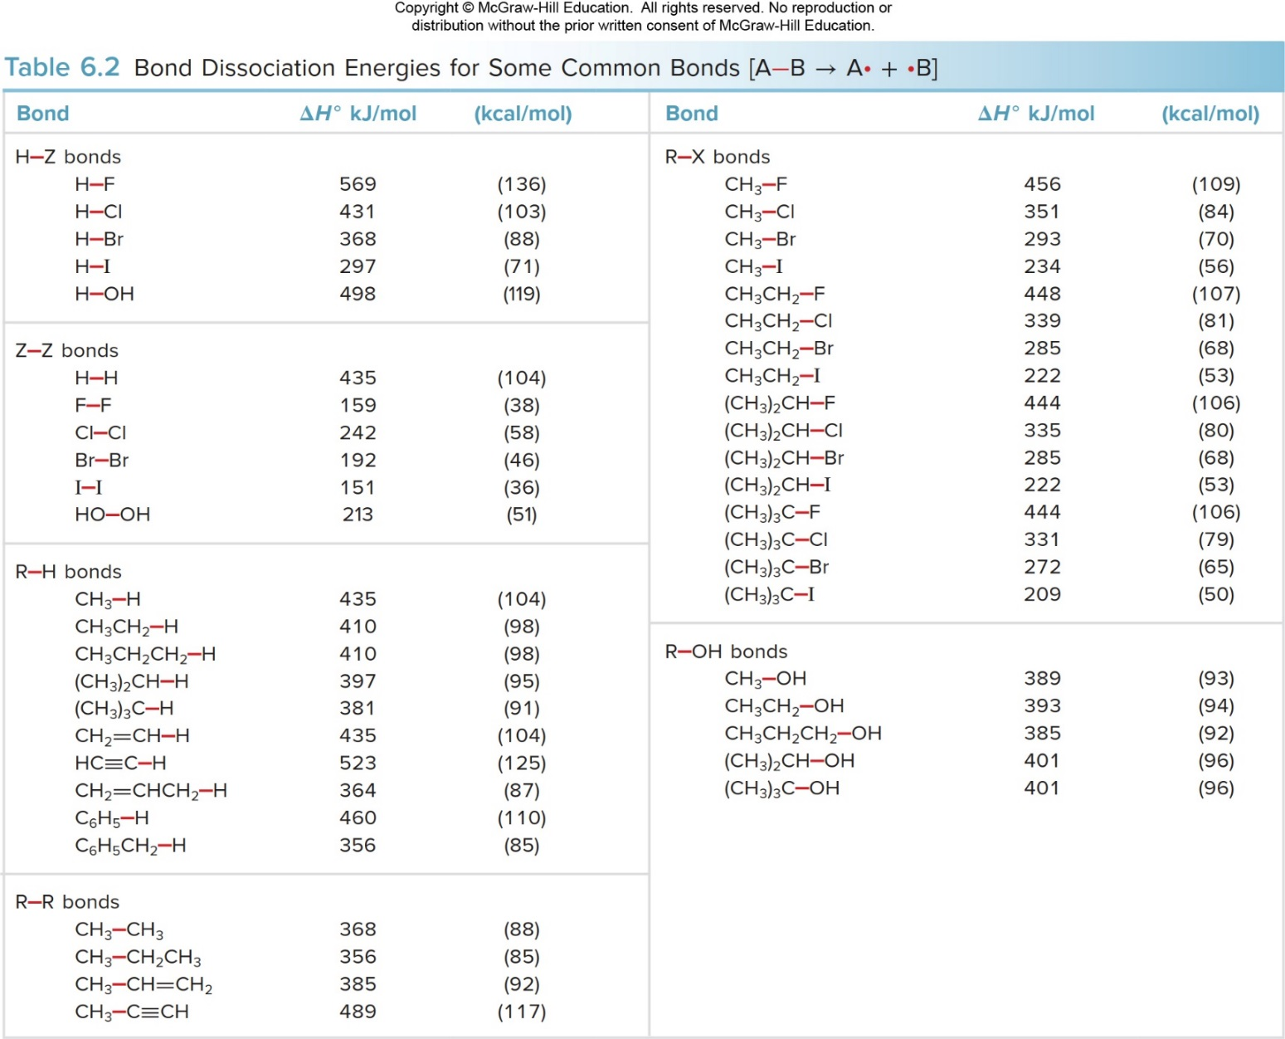
Energy Associated with the 𝐇𝟐 Bond-1
Organic Chemistry Sixth Edition, Janice Gorzynski Smith University of Hawai’I Chapter 1,3 and 6

